Slide 1
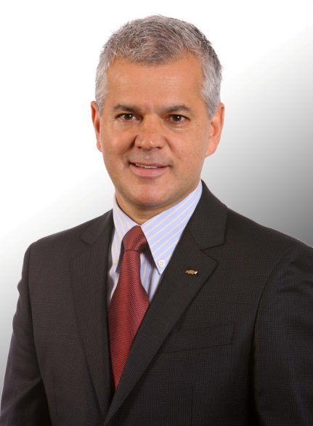

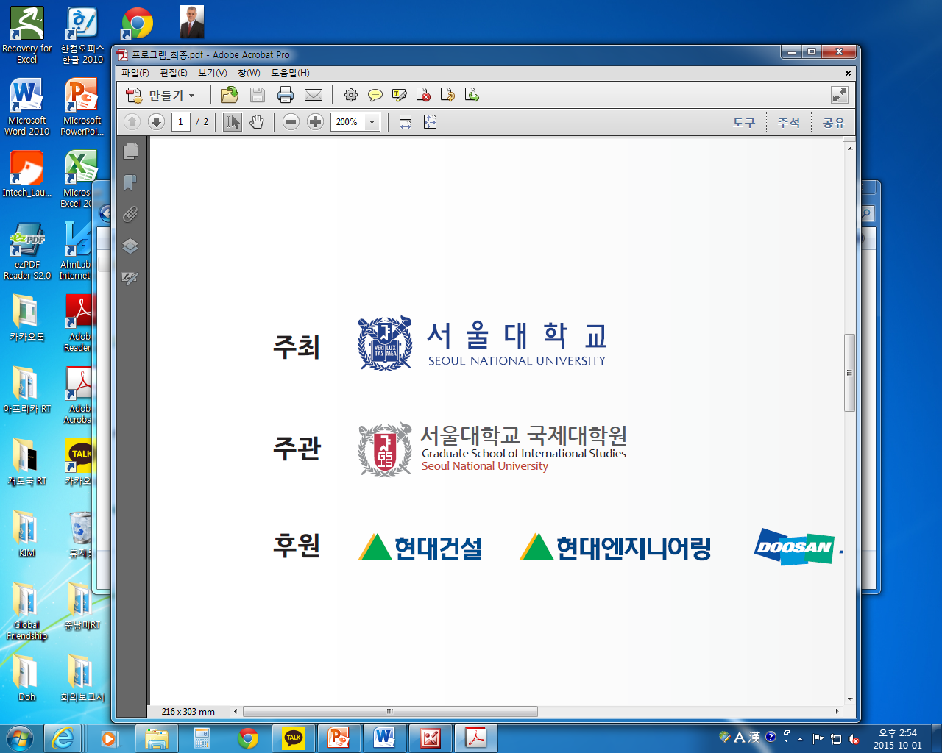
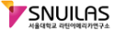


Special Lecture
중남미 출신 기업가, 한국에서 글로벌 기업을 경영하다
A Latin Managing a Global Company in Korea
Sergio Rocha
세르지오 호샤
President and CEO,
GM Korea Company
Date: October 14 (Wed.) 2015, 16:00 – 17:30
Venue: International Conference Hall, 4th fl.,
Bldg. 140-2, GSIS
Language: English
주최/주관:

